Slide 1
CORPORATE ACCOUNTING
DEPARTMENT OF COMMERCE
CELIN K A

Slide 2
DAY 1

Slide 9
DAY 2

Slide 28
DAY 3

Slide 29
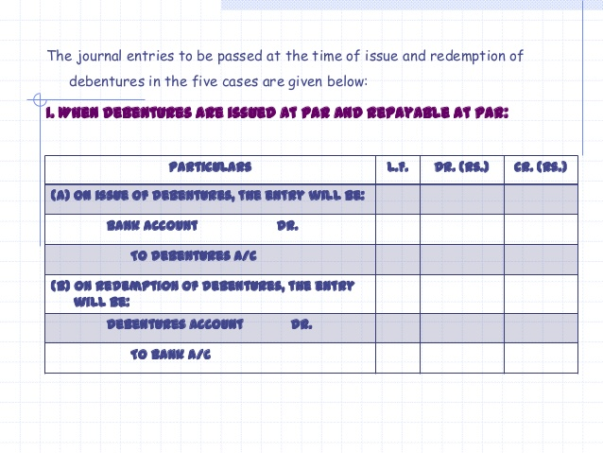

Slide 30
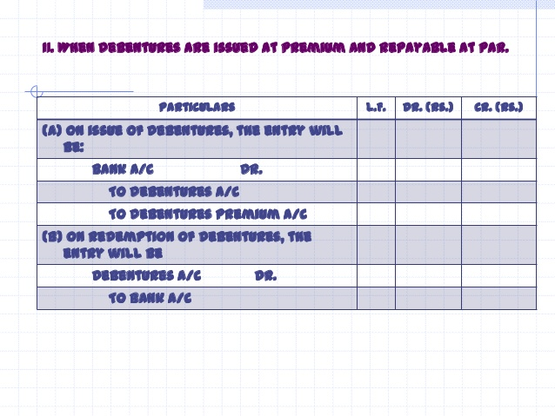

Slide 32
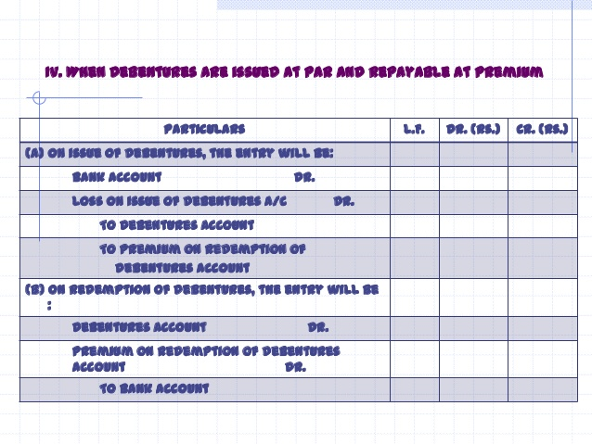

Slide 33
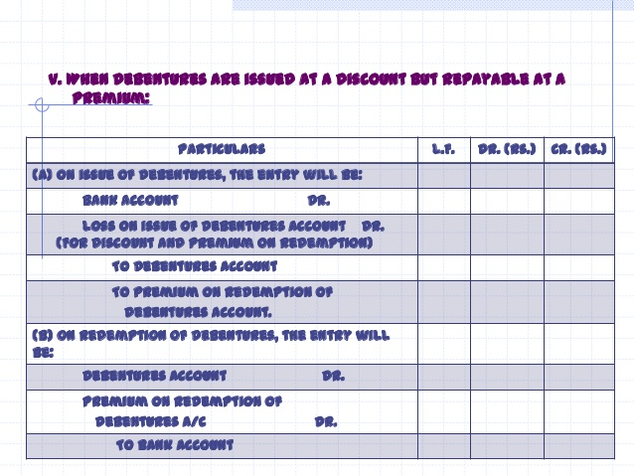

Slide 34
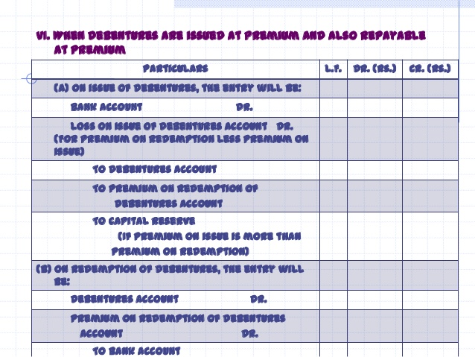

Slide 35
DAY 4

Slide 41
DAY 5

Slide 42
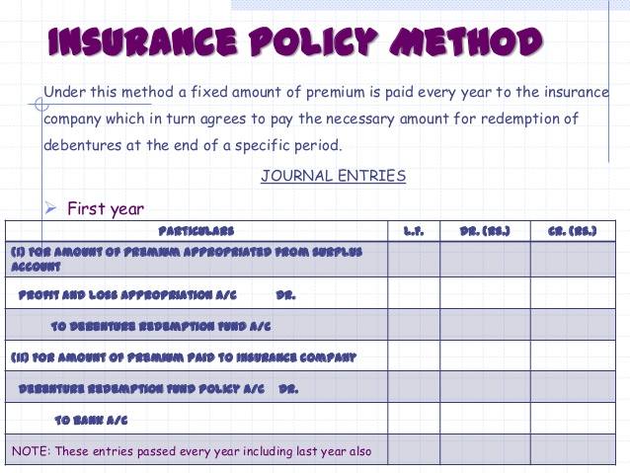

Slide 43
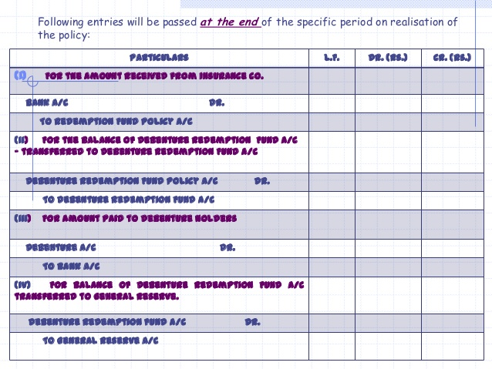

Slide 44
DAY 6

Slide 47
DAY 7

Slide 66
DAY 8

Slide 73
DAY 8

Slide 79
DAY 9

Slide 83
DAY 10

Slide 95
DAY 11

Slide 96
ACCOUNTING FOR INSURANCE COMPANIES

Slide 98
